Slide 1
CBT
Name
Institution

Slide 2
Introduction
Cognitive-behavioral therapy (CBT) is a form of psychotherapy used in the management of clients with a wide range of psychiatric disorders (Matweychuk, DiGiuseppe & Gulyayeva, 2019).
CBT intends to help clients become aware of their cognitive distortive and negative behavioral patterns.
Additionally, cognitive-behavioral therapy aims to help clients reduce their psychological stress by altering their thinking and behavior.
CBT helps to improve life balance, health and daily routine.

Slide 3
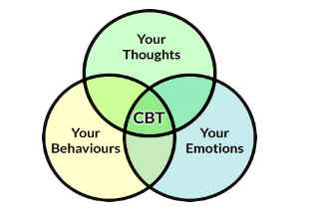
Areas addressed by CBT

Slide 4
How it Improves life balance
CBT helps patients overcome additions to drugs by:
  Availing self-help tools that boost their moods
  Demystify false claims that always lead to substance use and abuse
  Teaching effective communication skills
Patients are helped to deal with triggers thus avoid substance and drug abuse.
Depression is overcome using CBT leading to a balanced and healthy life. This method addresses a person’s though records to ensure they have the right kind of thoughts. In so doing, they avoid depression and anxiety which limit their quality of life.
(Hofmann et al. 2012)

Slide 5
Health and daily routine
Using CBT, an individual’s eating habits can be corrected. This is an eating disorder which affects life and routines. Therapy can address binge eating as well as the lack of eating which may be due to other factors as stress (physical and emotional).
CBT is an effective strategy to restore health, life balance and daily routines. It should be encouraged on all fronts at all cost.
(Hofmann et al. 2012)

Slide 6
Reference
Hofmann, S. G., Asnaani, A., Vonk, I. J., Sawyer, A. T., & Fang, A. (2012). The efficacy of cognitive behavioral therapy: A review of meta-analyses. Cognitive therapy and research, 36(5), 427-440.

